Slide 1
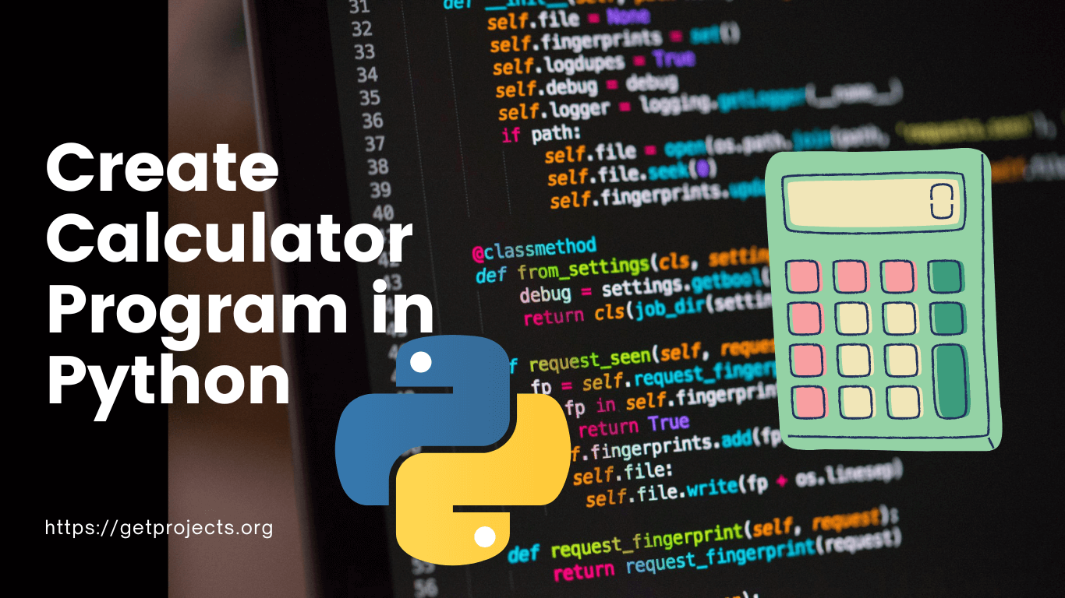
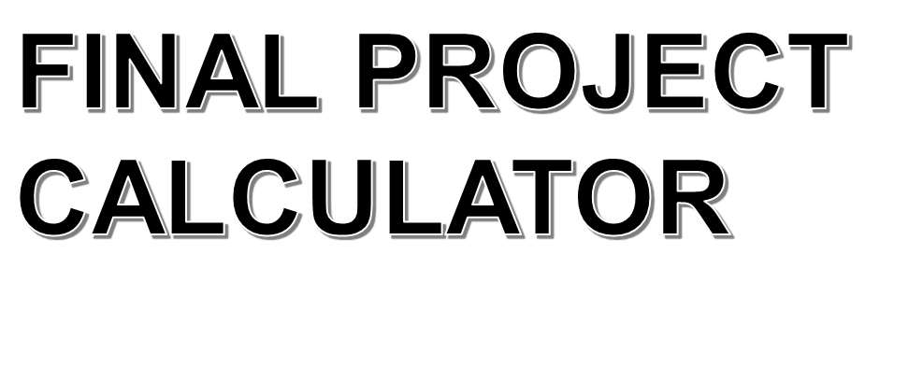

Slide 2

TEAM MEMBERS (Team 10)
Daniel Sany Tchamdeu
Birra Munir
Induruwa Acharige Janitha Chathuranga
Herath Mudiyanselage Wimansi Buddhika Herath
Randunu Pathirannehelage Akila Madhushanka Pathirana

Slide 3
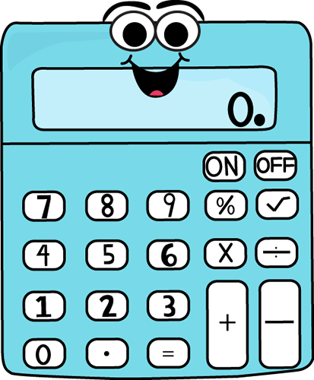
Why we choose this topic?
Familiar with coding- previous exercise
Easy to understand and explain
Useful for everyone

Slide 4

How we approach to the project?
Team discussions (Zoom+ WhatsApp)
  To select this topic
Trello Board- Divide tasks
Lesson learnt from this course
Find relevant knowledge from the internet

Slide 5

Challenges we met?
Limited time frame (1 week)
Group members from different time zones
Beginners to coding (Not all are fluent in coding)
Coding errors

Slide 6

Overcoming Challenges ?
Identified our skills and shared work (Trello)
Frequent discussions (Zoom +WhatsApp)
Managed time with other assignments
Referred to the internet.

Slide 7
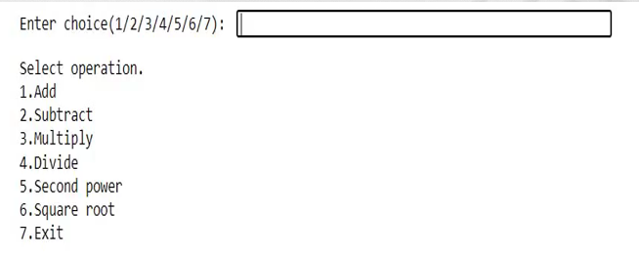
PROJECT DESCRIPTION
Basic calculator developed using python and jupyter notebook.
  + ,- , ÷ , (×), x², √
User has to choose one operation from.

Slide 8




Teamwork
  Dividing Project into parts
    Daniel, Birra, Janitha, - Coding + Task monitoring
    Buddhika- Project documentation + PPT
    Randunu- Project documentation + Presenter + PPT
  Deadline to finish coding 11th Saturday-
  Deadline to finish PPT 13th Sunday -
  Final Discussion 14th Monday -

Slide 9

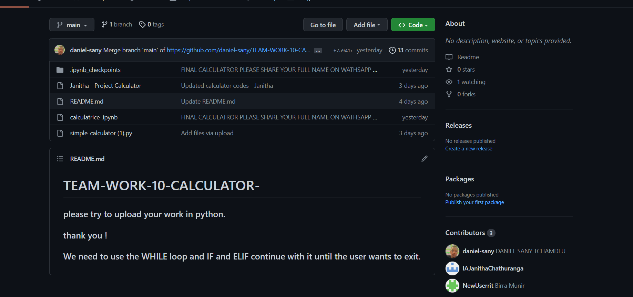
Version Control
GitHub Repository- source code hosting and version controlling.

Slide 10
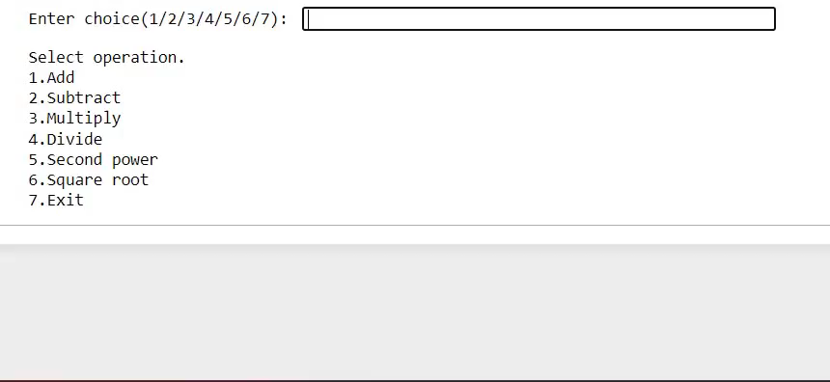
Demo

Slide 11
Limitations vs. Improvements to be done
Limitations | Improvements to be done
No GUI | Add GUI
Calculations are limited to only 2 (or 1) numbers eg: Num1+Num2, Num1/Num2, (Num1)^2 | Need further developments in coding to enable multiple numbers with multiple operations eg: (Num1+Num2)/Num3+(Num4)^2
Basic Calculator | Scientific calculator (Sin x, Cos x…)

Slide 12
Q&A

Slide 13
Thank You!

